Slide 1
2048 game
Made By: Faizan Nabi

Slide 2
Introduction
A captivating puzzle game that challenges your strategic thinking and number manipulation skills.
Merge numbered tiles on a 4x4 grid to reach the elusive tile of "2048".

Slide 3
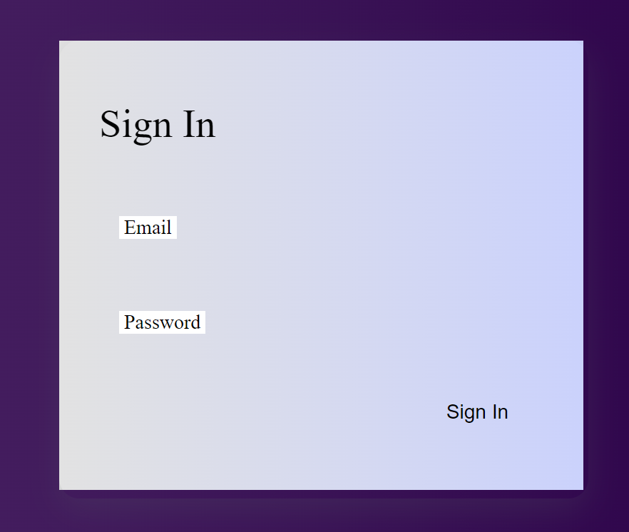
Login form
Once user enter its credentials,
the credentials are sent to game database in login table

Slide 4
What is 2048?
2048 is a single-player sliding block puzzle game.
It was created in March 2014 by Italian web developer Gabriele Cirulli.
The objective is to slide numbered tiles on a grid to combine them and create a tile with the number 2048.

Slide 5
Game Mechanics
The game is played on a 4x4 grid.
Tiles with numbers (powers of 2) appear randomly on the grid.
You move tiles by sliding them in four directions: up, down, left, or right.
When two tiles with the same number touch, they merge into one tile with the sum of their values.

Slide 6
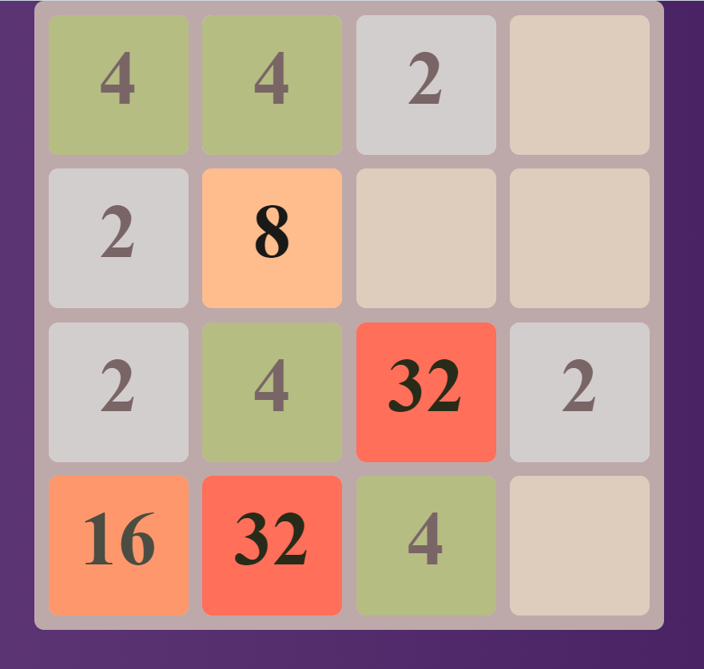
Game board

Slide 7
Objective
The ultimate goal is to create a tile with the number 2048.
But don't stop there! You can keep playing to achieve higher numbers and higher scores.
The game ends when the grid fills up and there are no more moves available.

Slide 8
Tips for Success
Plan Ahead: Anticipate the consequences of each move before making it.
Keep the Board Open: Try to maintain as much open space as possible to allow for more tile movements.
Focus on the Largest Tile: Prioritize merging tiles to build towards the highest number tile.
Don't Chase High Values: While aiming for high-value tiles is important, avoid sacrificing the game's flow for it.

Slide 9
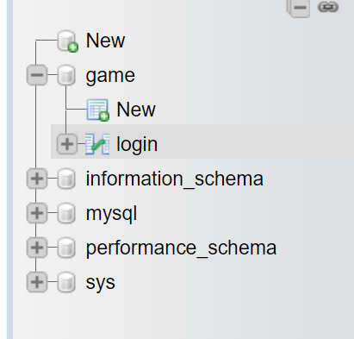
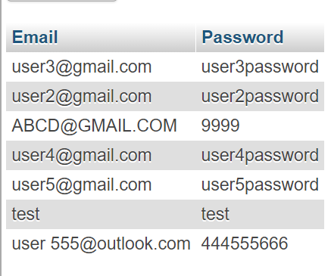
Backend
All Databases
Maintained Records

Slide 10
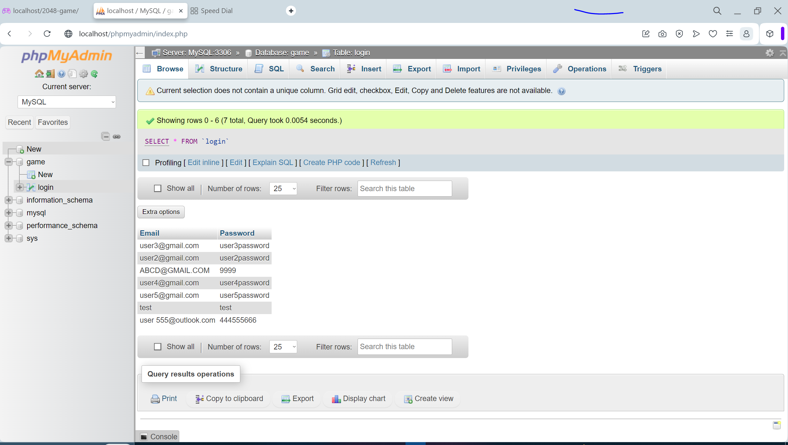
Backend View
Full Picture

Slide 11
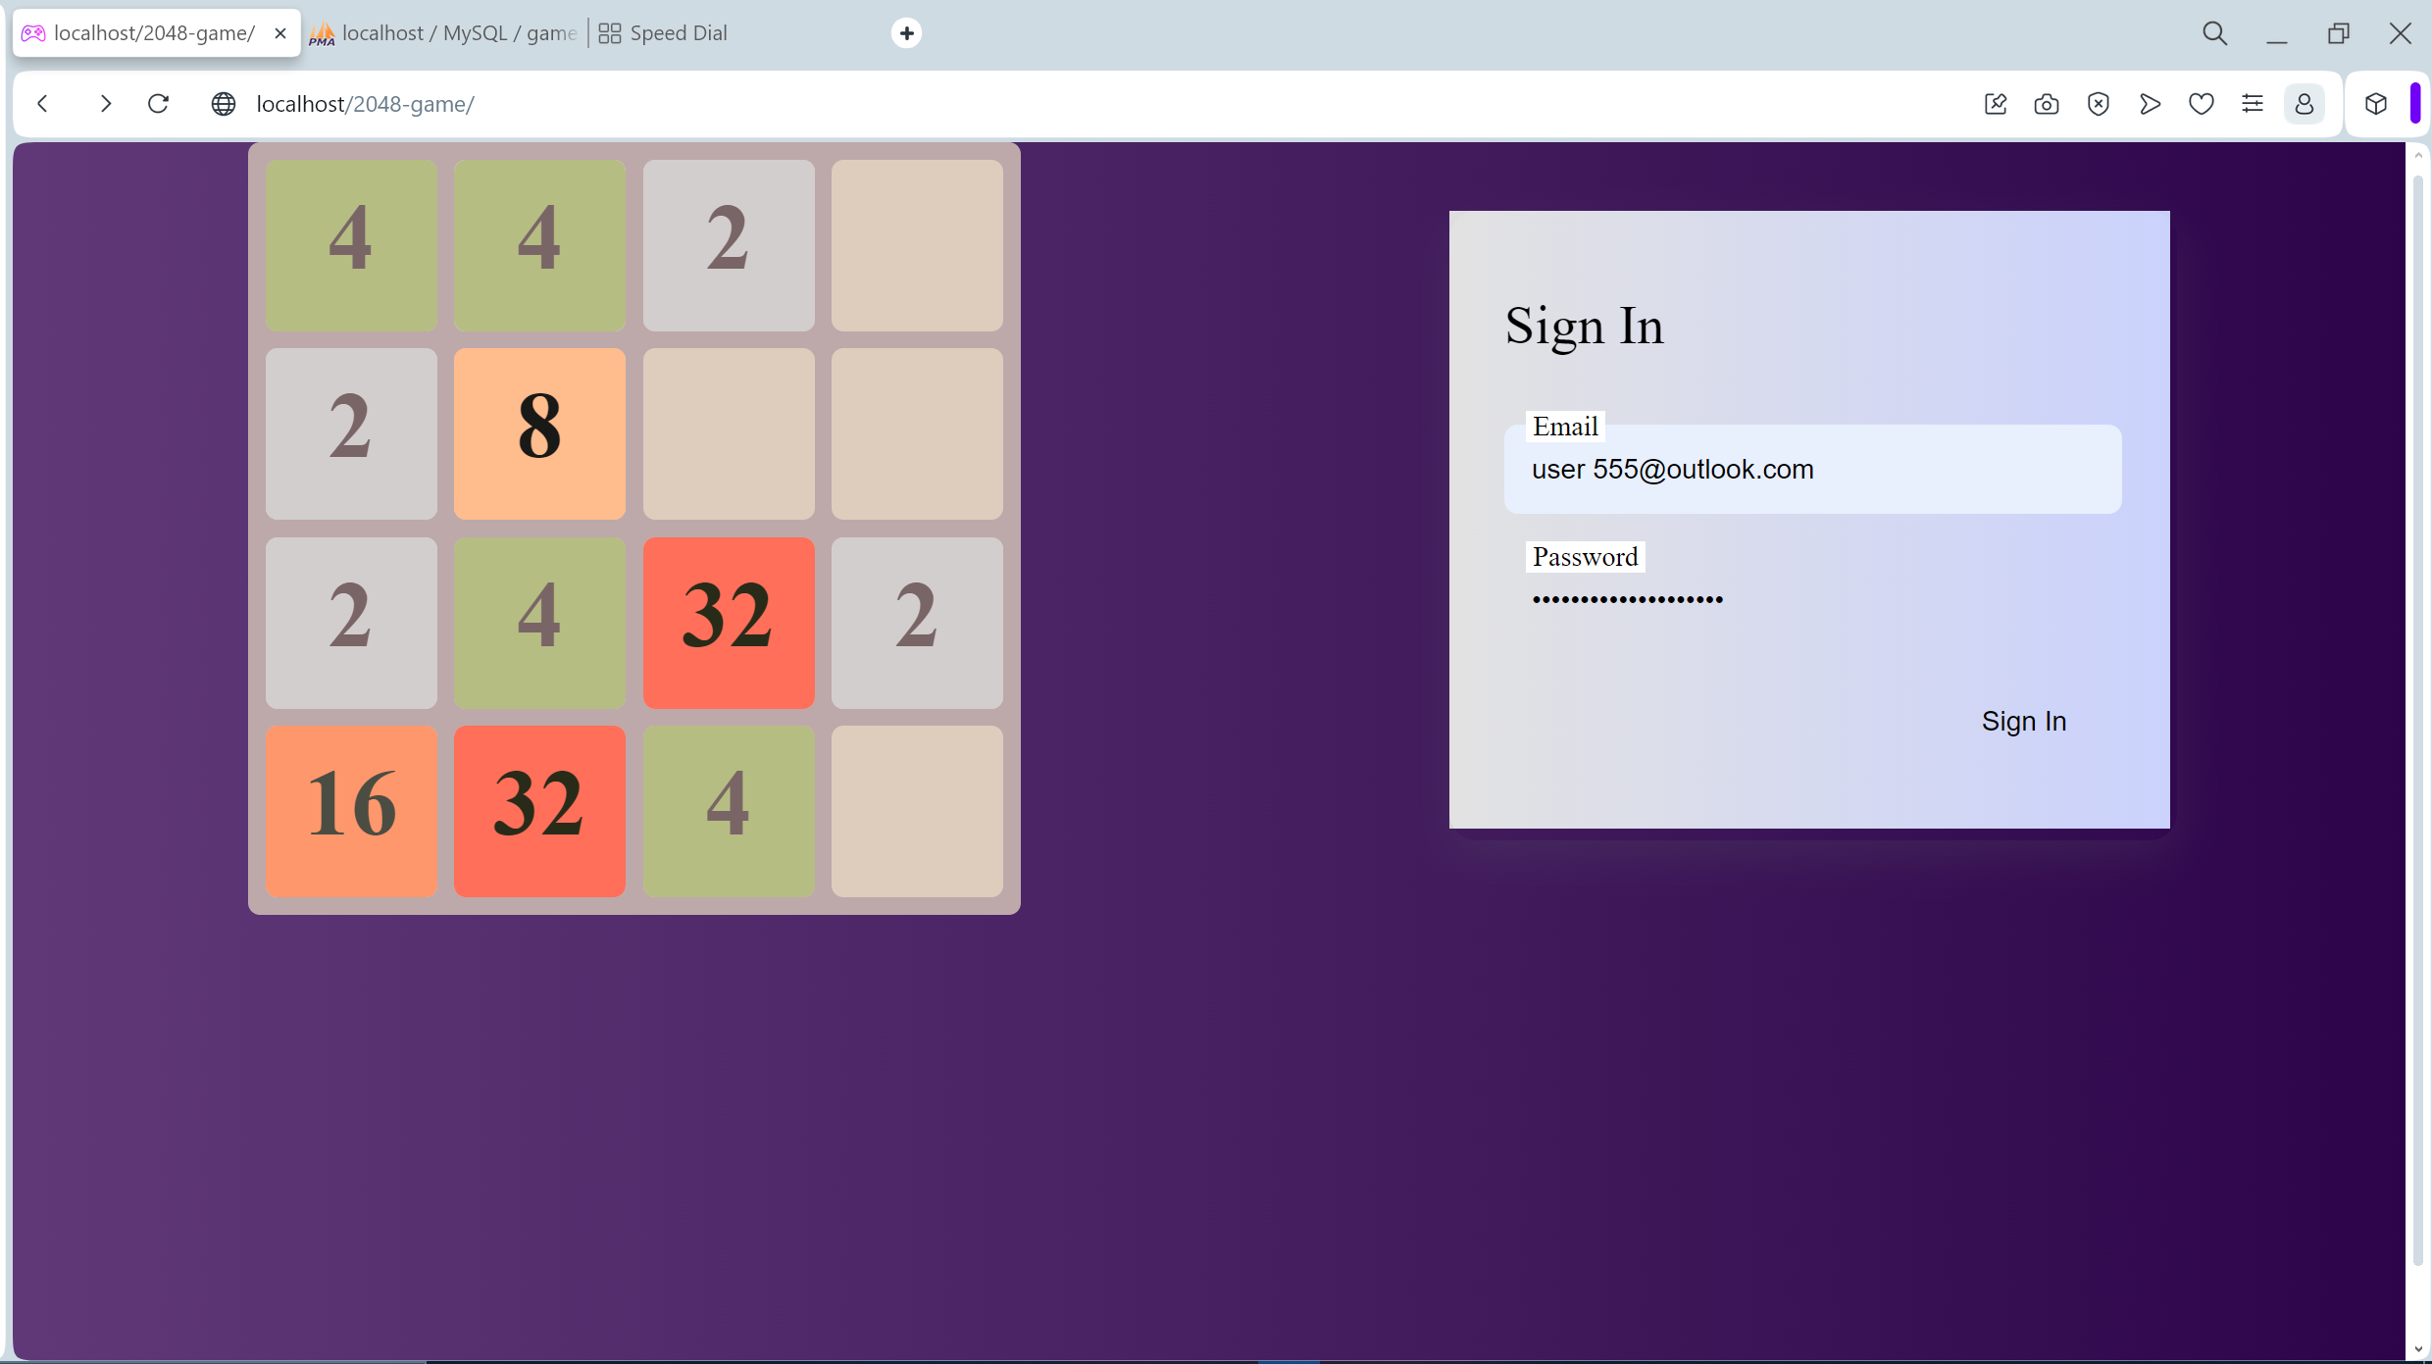
frontend view

Slide 12
Conclusion
2048 is a captivating puzzle game that challenges your strategic thinking and problem-solving skills.
With its simple rules and endless possibilities, it's no wonder that 2048 has become a favorite among puzzle enthusiasts.
We hope this presentation has provided you with valuable insights and strategies to enhance your 2048 gameplay experience!

Slide 13
The end
For demonstration watch my video

